Slide 1


School of Computing Science and Engineering
Subject Name: Linear Algebra And Differential Equation Subject Code: BBS01T1003
CAT-3 PRESENTATION
Program Name : B.TECH CSE
Section : 24
Session : 2021-2022
Group Members:-
Name: Aviral Gaurav
Admission no. : 21SCSE1300029
Name: Abhinav Kumar Choudhary
Admission no. : 21SCSE1011615
Name: Deepansh Bhatia
Admission no. : 21SCSE1011677
Name: Neeraj Singh
Admission no. : 21SCSE1011675
Name: Ashutosh Rai
Admission no. : 21SCSE1011691
Submitted to:
Dr. Vanita Garg

Slide 2
TOPIC
One dimensional wave equation as mathematical model of vibrations of a stretched string, solution of 1-dim wave equation by SOV method

Slide 3
SOLUTION
Consider a uniform elastic string of length / stretched tightly between points O and A and displaced slightly from its equilibrium position OA. Taking the end O as the origin, OA as the axis and a perpendicular line through O as the y-axis, we shall find the displacement y as a function of the distance x and time t.

Slide 4
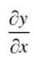
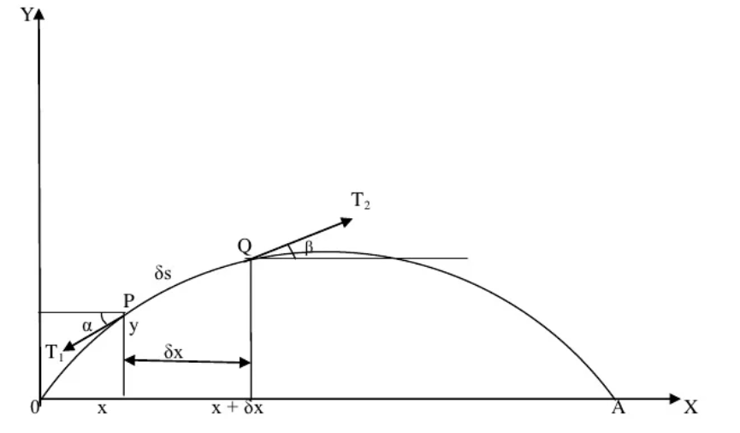
Assumptions
(i)Motion takes places in the XY plane and each particle of the string moves perpendicular to the equilibrium position OA of the string.
(ii) String is perfectly flexible and does not offer resistance to bending.
(iii)Tension in the string is so large that the forces due to weight of the string can be neglected.
(iv) Displacement y and the slope are small, so that their higher powers can be neglected.

Slide 5
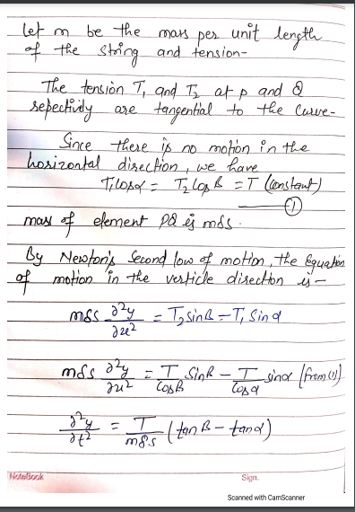
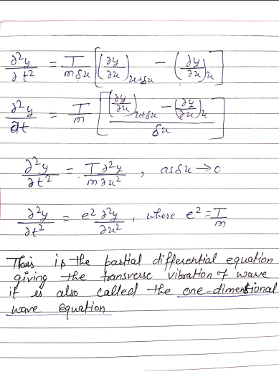

Slide 6
Solution of 1-dim
by Separating Variables

Slide 7
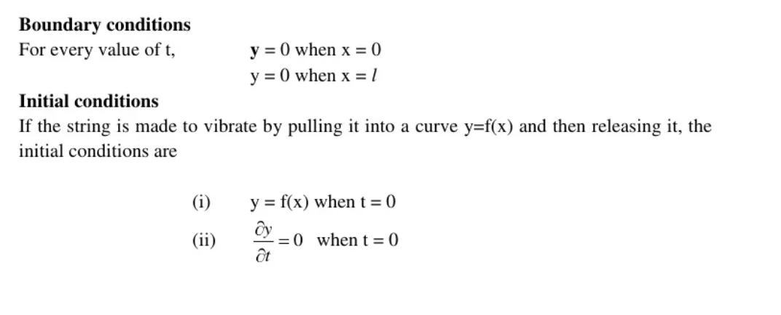

Slide 8
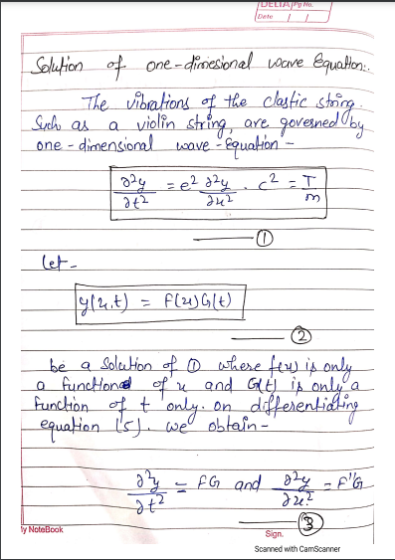
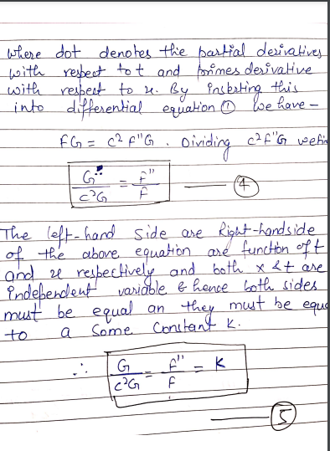

Slide 9
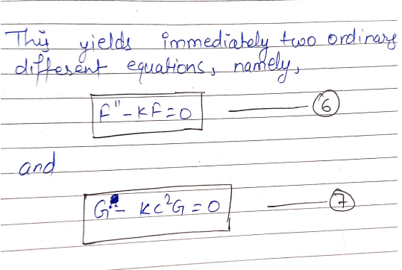

Slide 10
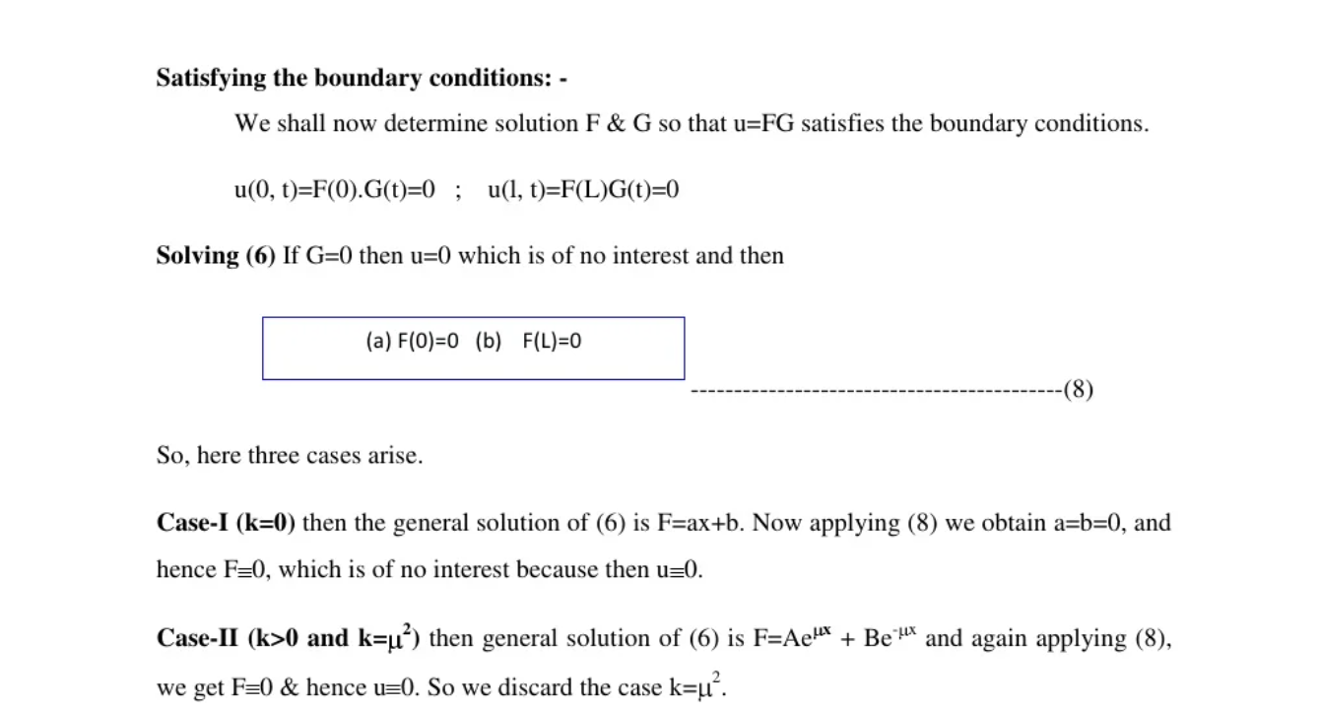
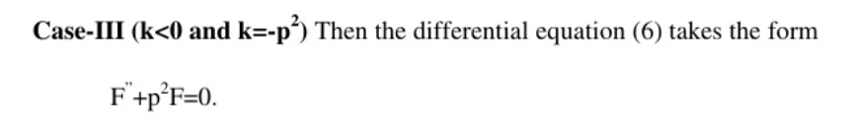

Slide 11
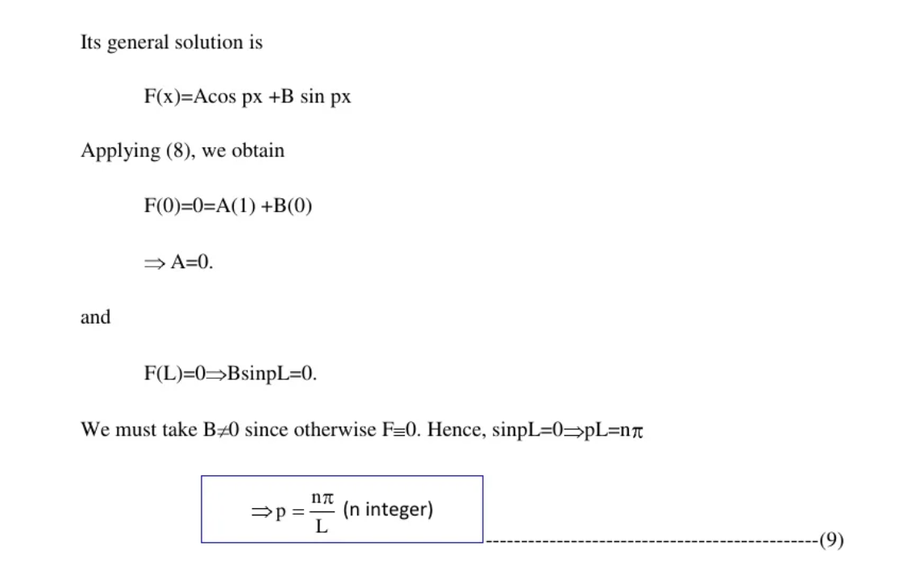

Slide 12
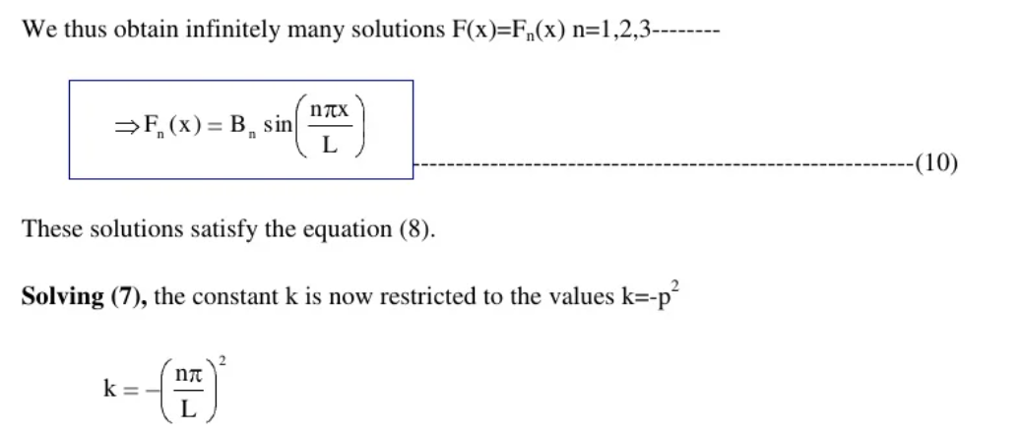

Slide 13
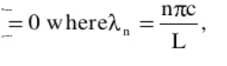
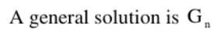
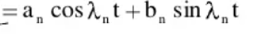
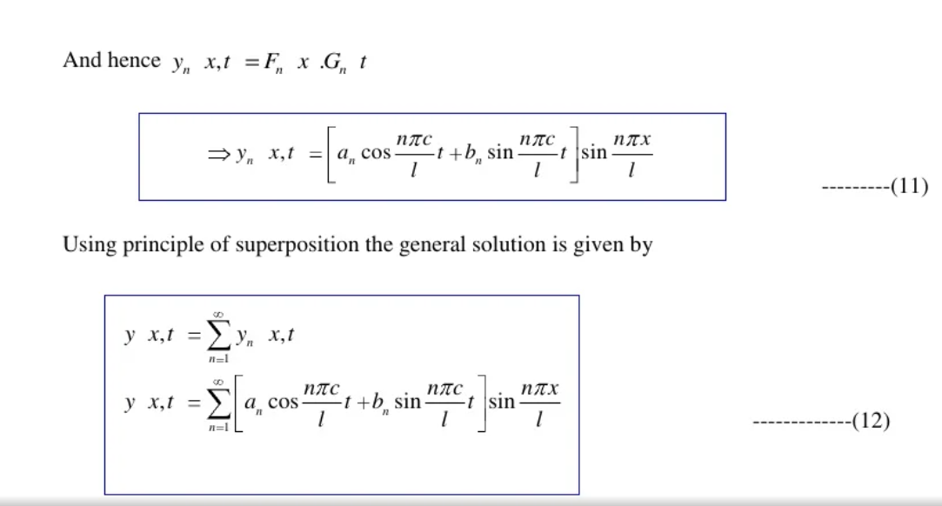

Slide 14
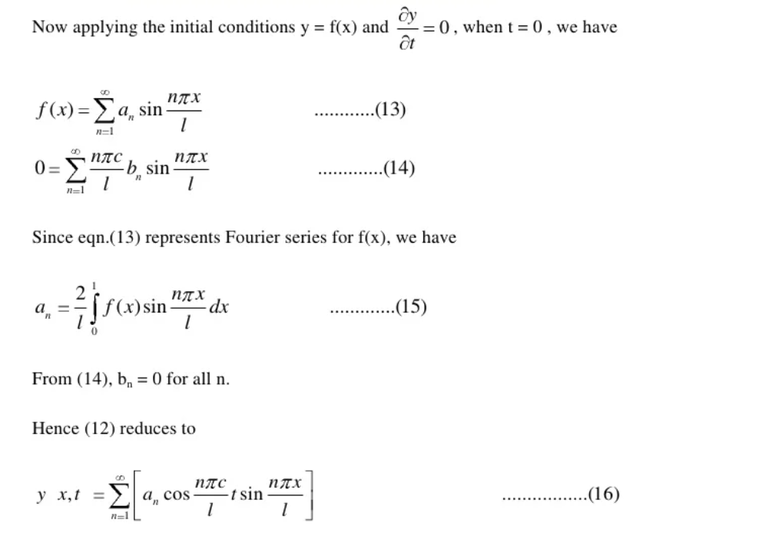

Slide 15
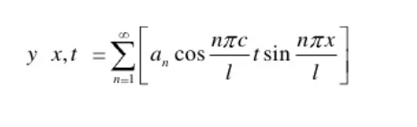
Our Final Equation is :

Slide 16
REFRENCES
www.google.com
www.wikepedia.org
https://www.slideshare.net/neerajparmar68/1-d-wave-equation
KreyzigAdvanced Engineering Mathematics 10th Edition

Slide 17


